Slide 1
SUPERSTORE SALES
BSTAT-5325-001 TEAM 08
Afzal Imaan
Christian Kamarga
Santosh Kusuma
Surendra Mantena
Cameron Royes
Ruchi Shukla

Slide 2
Data Insight
Goal
We wanted to predict overall sales for the coming year and more specifically how products will perform based on previous years’ data.
Application of Measurements
These measurements and models can be useful for stores in making management operational decisions, customer insight, and inventory related decisions for future growth of the store.

Slide 3
Data Overview
Our data shows the sales of a superstore from 2018-2021.
The types of products in the dataset are categorized by office supplies, furniture, and technology.
We categorized sales quarterly for our predictions in 2022.
Through our regression analysis we were able to come out with a high correlation from our R squared and adjusted R squared measurements which gave us indication that going forward our predictions would be more accurate and decided to move forward.

Slide 4
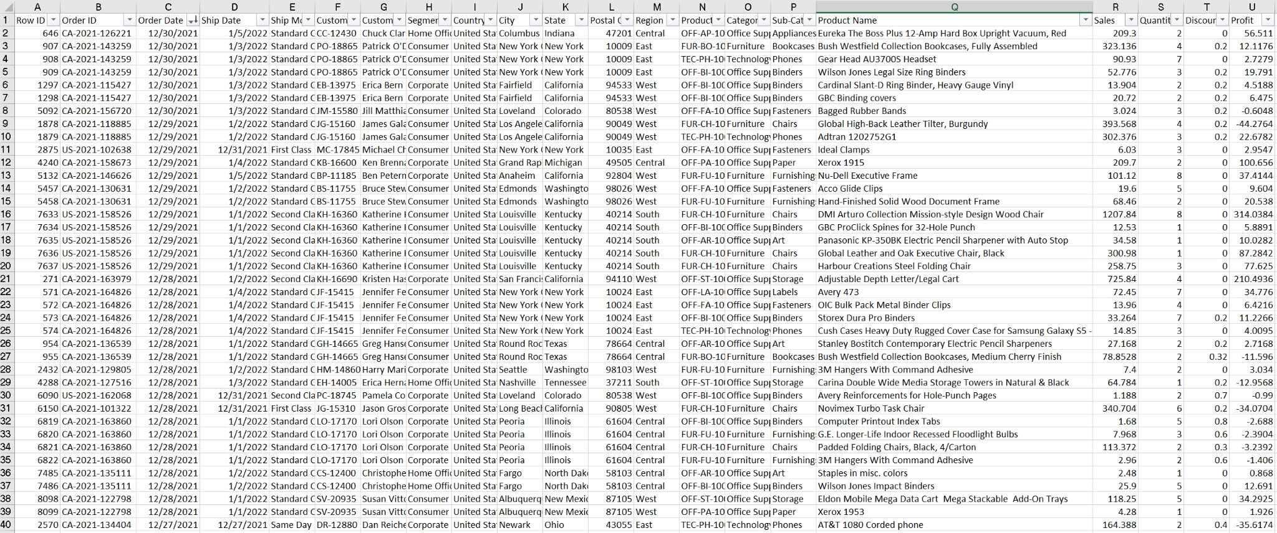
The Dataset

Slide 5
Questions to Answer
Can the data be used to predict sales of certain products (i.e. office supplies, furniture, and technology)?
What categories and subcategories will pose the greatest improvement and trend continuation?
Does location and shipping have any direct impact on business sales and/or profits?
How would this data benefit those within and beyond the superstore’s operations?
According to our sales prediction, how can we determine which state earns greater profit?

Slide 6
Multiple Regression Analysis
This model allows the analysis to measure the relationship and predictions between multiple independent variables and one dependent variable.
The correlation coefficient R Squared shows the correlation. A high correlation close to 1 indicates a good correlation between variables.
It also gives the mean squared error which shows the accuracy of predictions. A low MSE close to 0 shows that there is minimal error between the actual and observed measurements.
We used the multiple regression model to show correlation of our dataset and surpass limitations that constrained us in the linear regression model.

Slide 7
Variables
Independent
Category/Subcategory
Location variables (City, State, Postal, Region)
Shipping mode (Standard, Second, First, Same Day)
Segment
Profit, Quantity and Sales
Dependent
Sales (in U.S. Dollars)

Slide 8
Time Series Analysis
This is used in order to see how the actual and observed statistics show patterns and trends.
It is helpful for the visualization and prediction of future trends.
This is a very helpful model for outside consumers because of its visual and conceptual simplicity.
Our goal with this model was to accurately predict that future statistics as well as show continuation of the trend from previous years.
This was used for overall sales as well as the categories of products to provide greater context and specificity.

Slide 9
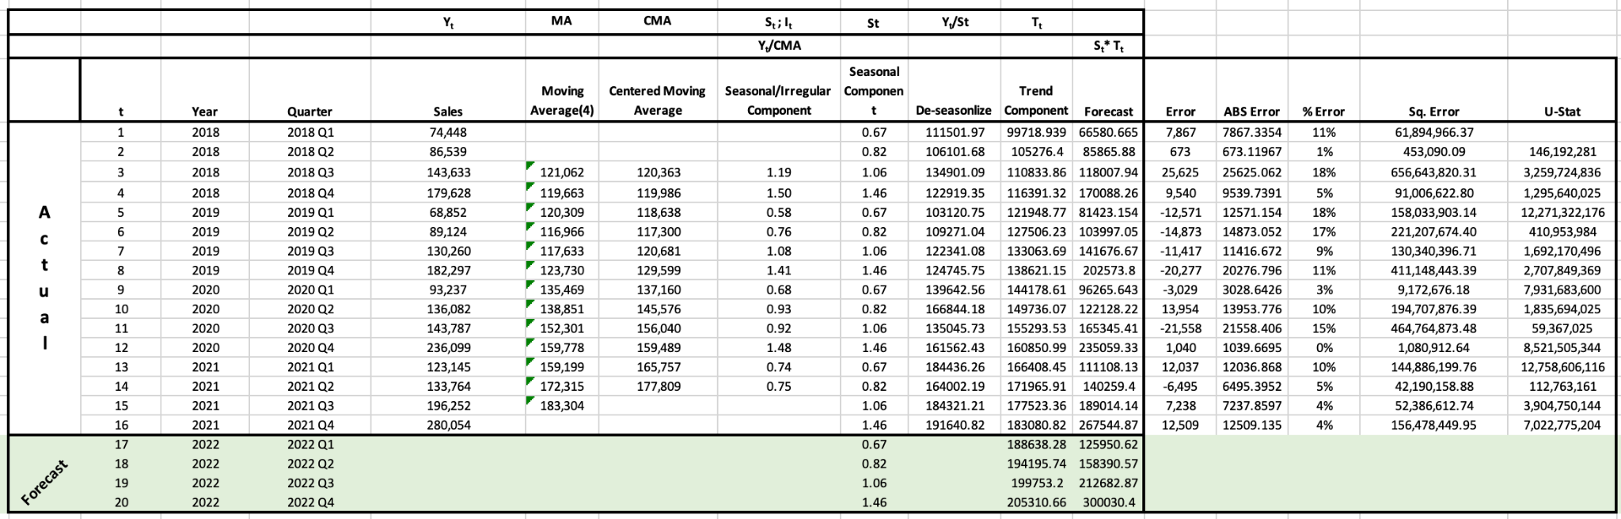
Total Sales and Forecast Data

Slide 10
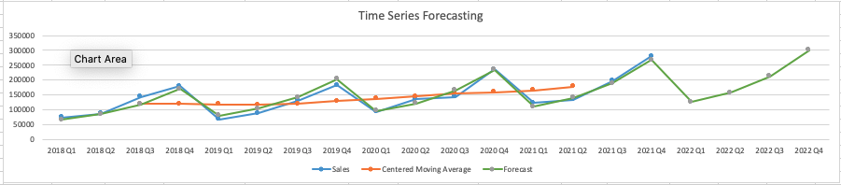
Sales Forecast
Through our time series forecast, we are able to see that Q4 posed the highest sales every year and seems to be similar with our predictions in 2022.
Our predictions for 2022 Q4 overall sales increase 12% from 2021 Q4 sales and plan to reach its highest quarterly sales.

Slide 11
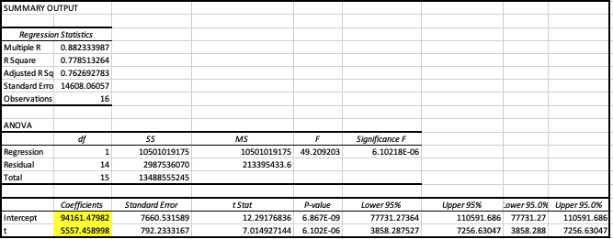
Regression Analysis

Slide 12
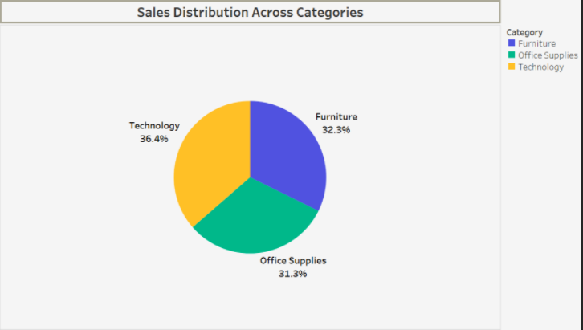
Sales Revenue by Category
Technology makes up the majority of sales revenue at 36.4%.
Relative to their respective quarters each year, we will see that there are increases for each of the four quarters.

Slide 13
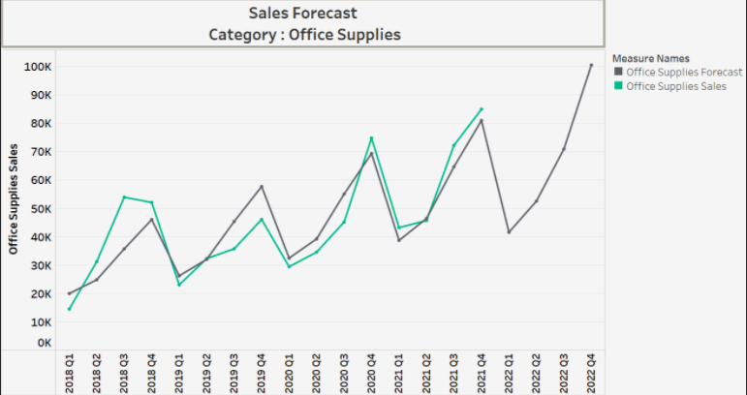
Office Supplies Forecast
The end of Q4 sales are projected to be $100,494 (A 18% increase from previous Q4 sales).
From the graph, the projections display a large increase in Q4 which would be an increase of 41% for Q3 2022 projections.

Slide 14
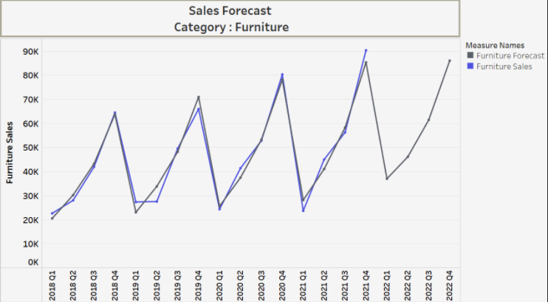
Furniture Forecast
Furniture is the only category that poses a decrease of 4.2% in sales from actual 2021 Q4 sales. Other projected quarters increase sales for 2022.

Slide 15
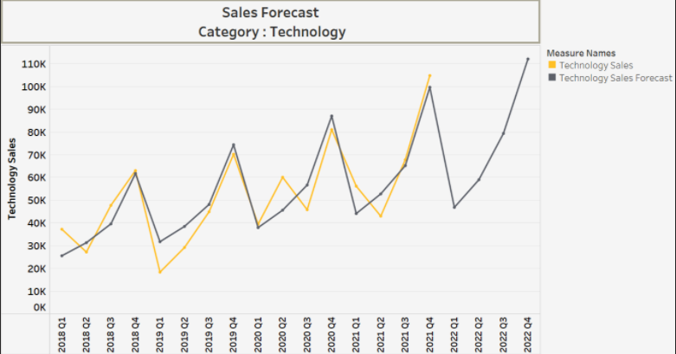
Technology Forecast
The Q4 2022 projections suggest there will be an increase of 7% for sales from Q4 2021 actual sales.
Technology is the highest grossing of revenue amongst the categories.

Slide 16
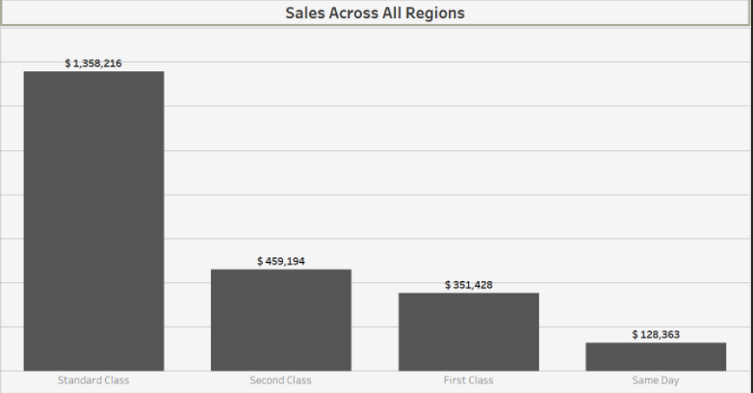
Shipping Method
Standard Class
Second Class
First Class
Same Day
Its lowest dollar amount can be inferred from that this is the most expensive or least affordable shipping method.
Conversely, the Standard Class has the highest dollar amount because it is presumably the most affordable or common shipping method.

Slide 17
Application to the Business Environment
This data can be applicable to outside consumers and vendors in gauging the market for certain products.
Outside factors that were not available and taken into account could be market share. If this supermarket had a large share of the market for any of the categories, this could be some indication where other supermarkets in the industry can focus and become more efficient.
Customers can use this information to understand when the best time to buy a product in order to maximize consumer surplus.
For example, all categories display lowest sales in the first quarter of the year. Promotions, sales and other motivations companies give to buy products could come in that time frame in order to boost sales.
The data yields information especially useful for the Superstore’s investors and shareholders.
The Sales data throughout the years for the Superstore business can indicate how well it is doing. If the results are perceived as positive and consistent, it may keep the current investors and shareholders happy.
It can look favorable for business prospects. This can attract potential business opportunities or more investors/shareholders interested in doing business with this Superstore.

Slide 18

Decision Tree Model
Decision Tree models can be built in various softwares Excel and Python, but ours was created through SAS Enterprise Miner.
A Datamining software tool.
Used and taught in UTA’s Datamining course, which can be taken concurrently with this BSTAT course.
Some of the concepts between the two classes have helped to realize this model.

Slide 19
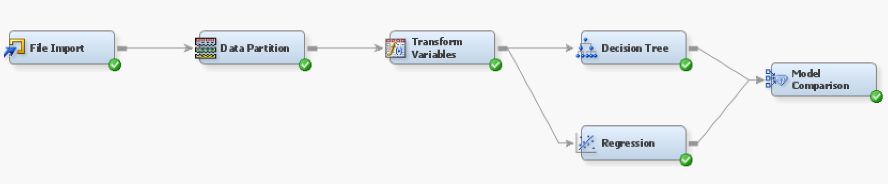

Slide 20
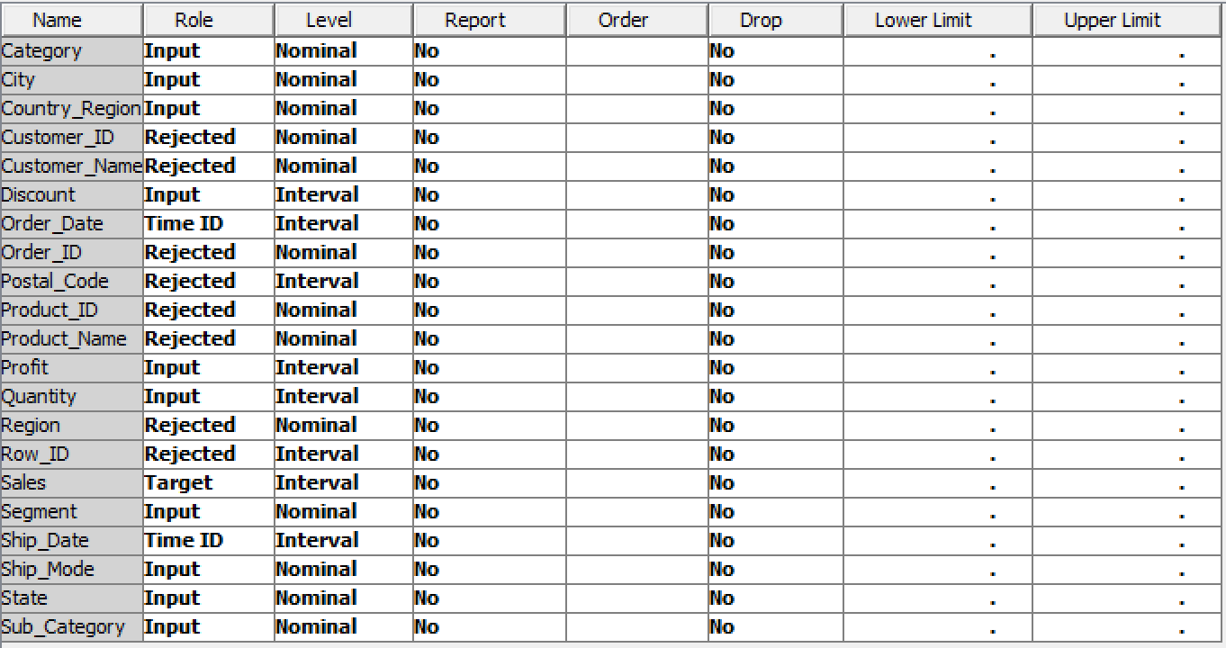
File Import - Edit Variables
The Excel file containing the Orders throughout the years was imported into SAS.
In this File Import node, we were able to set which columns would be included in our computations.
For instance, Sales is the Dependent or Response variable. This is why it is set to “Target”.
Some variables like “Customer_ID”, or columns that act as unique identifiers were rejected. They were excluded to make for reasonable calculations.

Slide 21
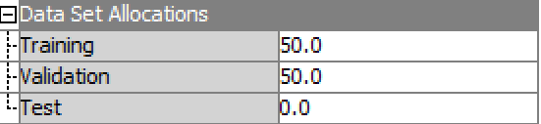
Data Partition
~10,000 records.
Set the Data Allocations:
Training 50%
Validation 50%
Partitioning means to “divide into parts”. By dividing the data into pieces, it is possible to compute efficient and functional models.
In the Training set, the machine utilizes the input data to learn how and when to make splits within a certain criteria.
In the Validation set, the machine uses the input data to verify if what it has learned from the Training set is sufficiently robust. It acts as the “brakes” for when the tree branches should stop splitting.
Supposedly, this is to prevent Overfitting the model.

Slide 22
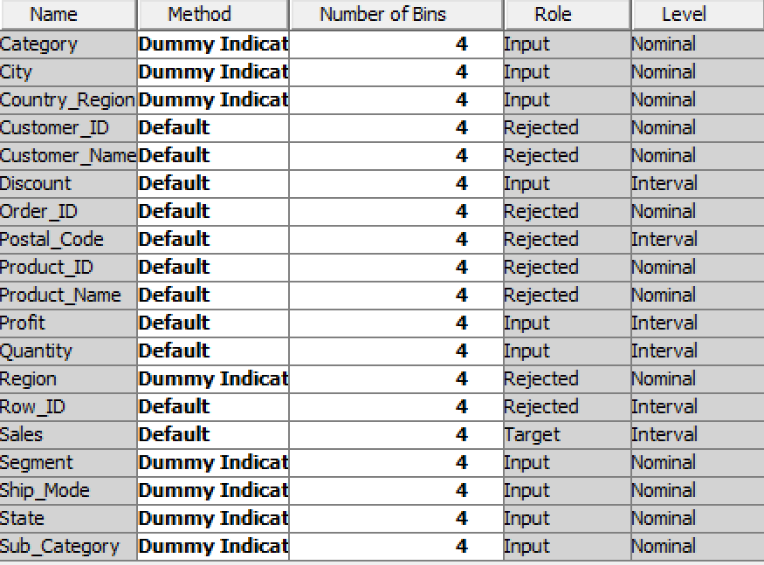
Transform Variables
Similar to the File Import node, this is where SAS is told which variables are treated as Dummy Variables.
One of them being Ship_Mode (Standard Class, Second Class, First Class, Same Day).
By setting a variable’s Method to “Dummy Indicator”, SAS would automatically compute it with the appropriate number of Dummy Variable values.

Slide 23
Decision Tree
The following Decision Tree model is a Regression Tree. It is a kind of Decision Tree used for predicting quantitative or numerical response variable(s).
It can also be used to analyze how the overall data is binned or grouped.
The tree starts at the Root level node. In every subsequent “level”, the node splits into two resulting child or leaf nodes. The way this is partitioned is based off of certain traits in the data.
For instance, rows of data fall into one node whether they are a Chair category. In another, they are grouped whether the Customer is having their Order shipped to the City of San Francisco.
Each node displays the count and average to indicate how many are applicable to a particular criterion.
Can use the predictions to compute three quantities:
Mean Squared Error (MSE)
Root Mean Squared Error (RMSE)
R-Square

Slide 24
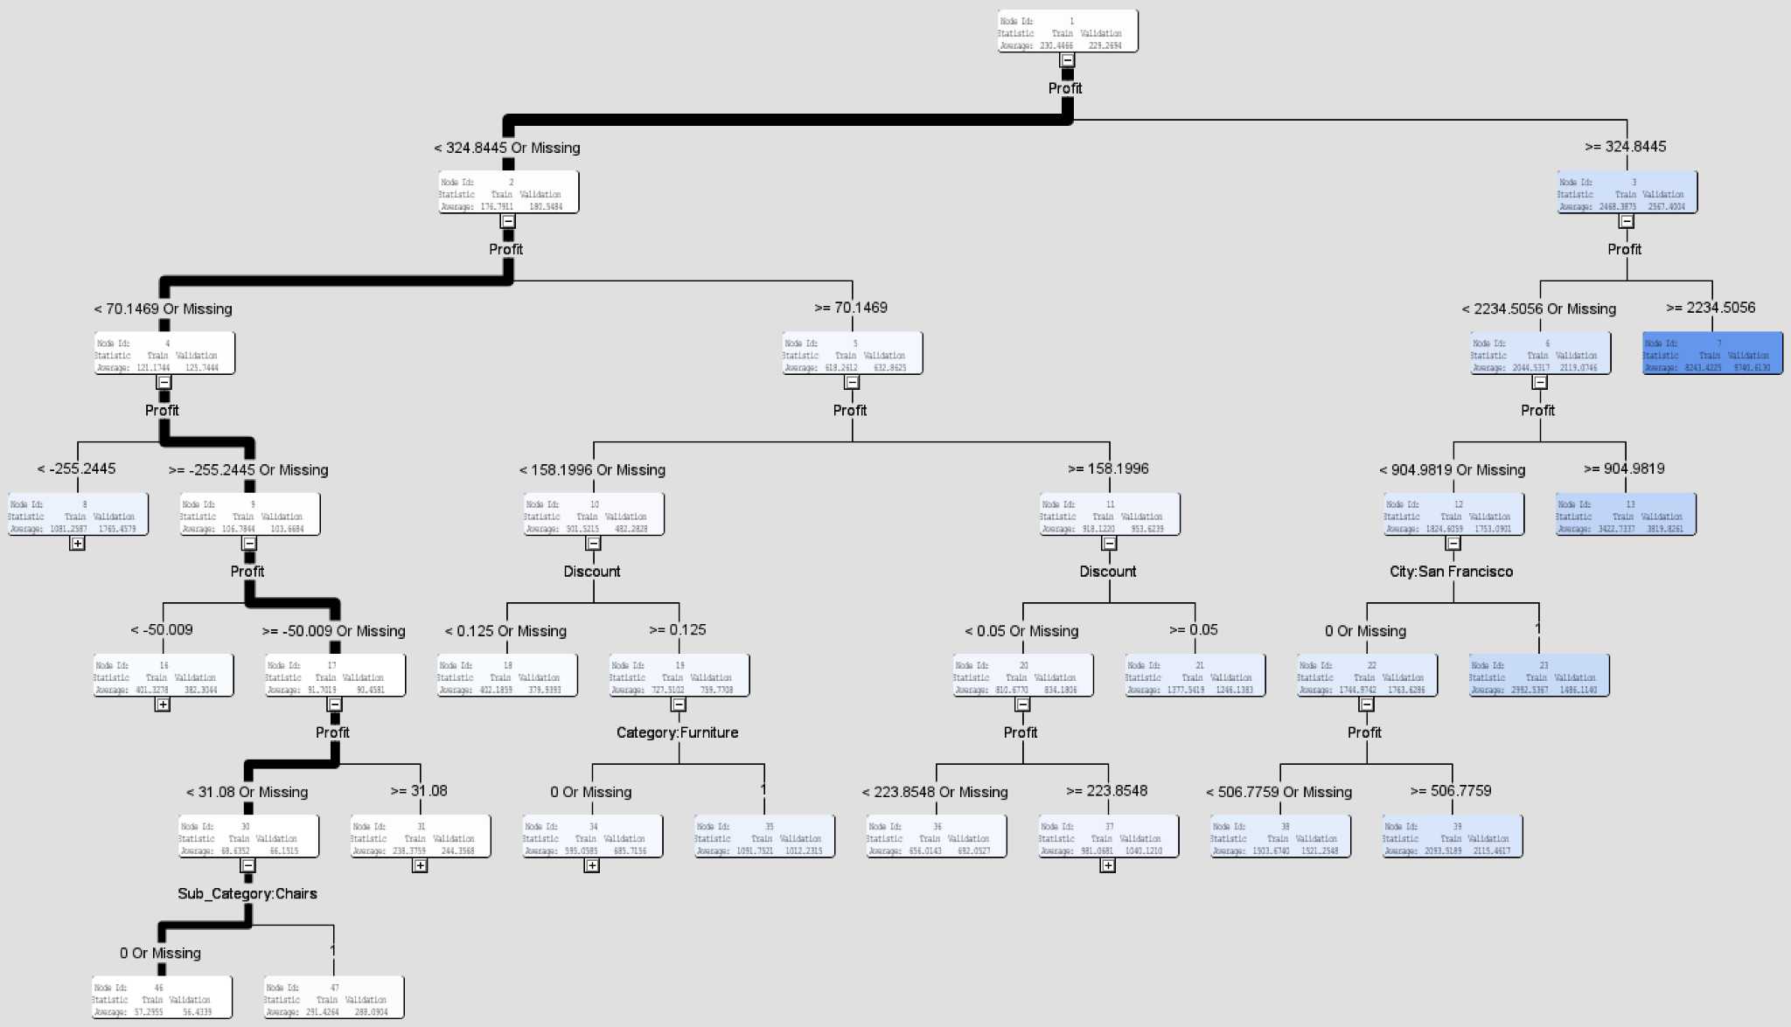

Slide 25
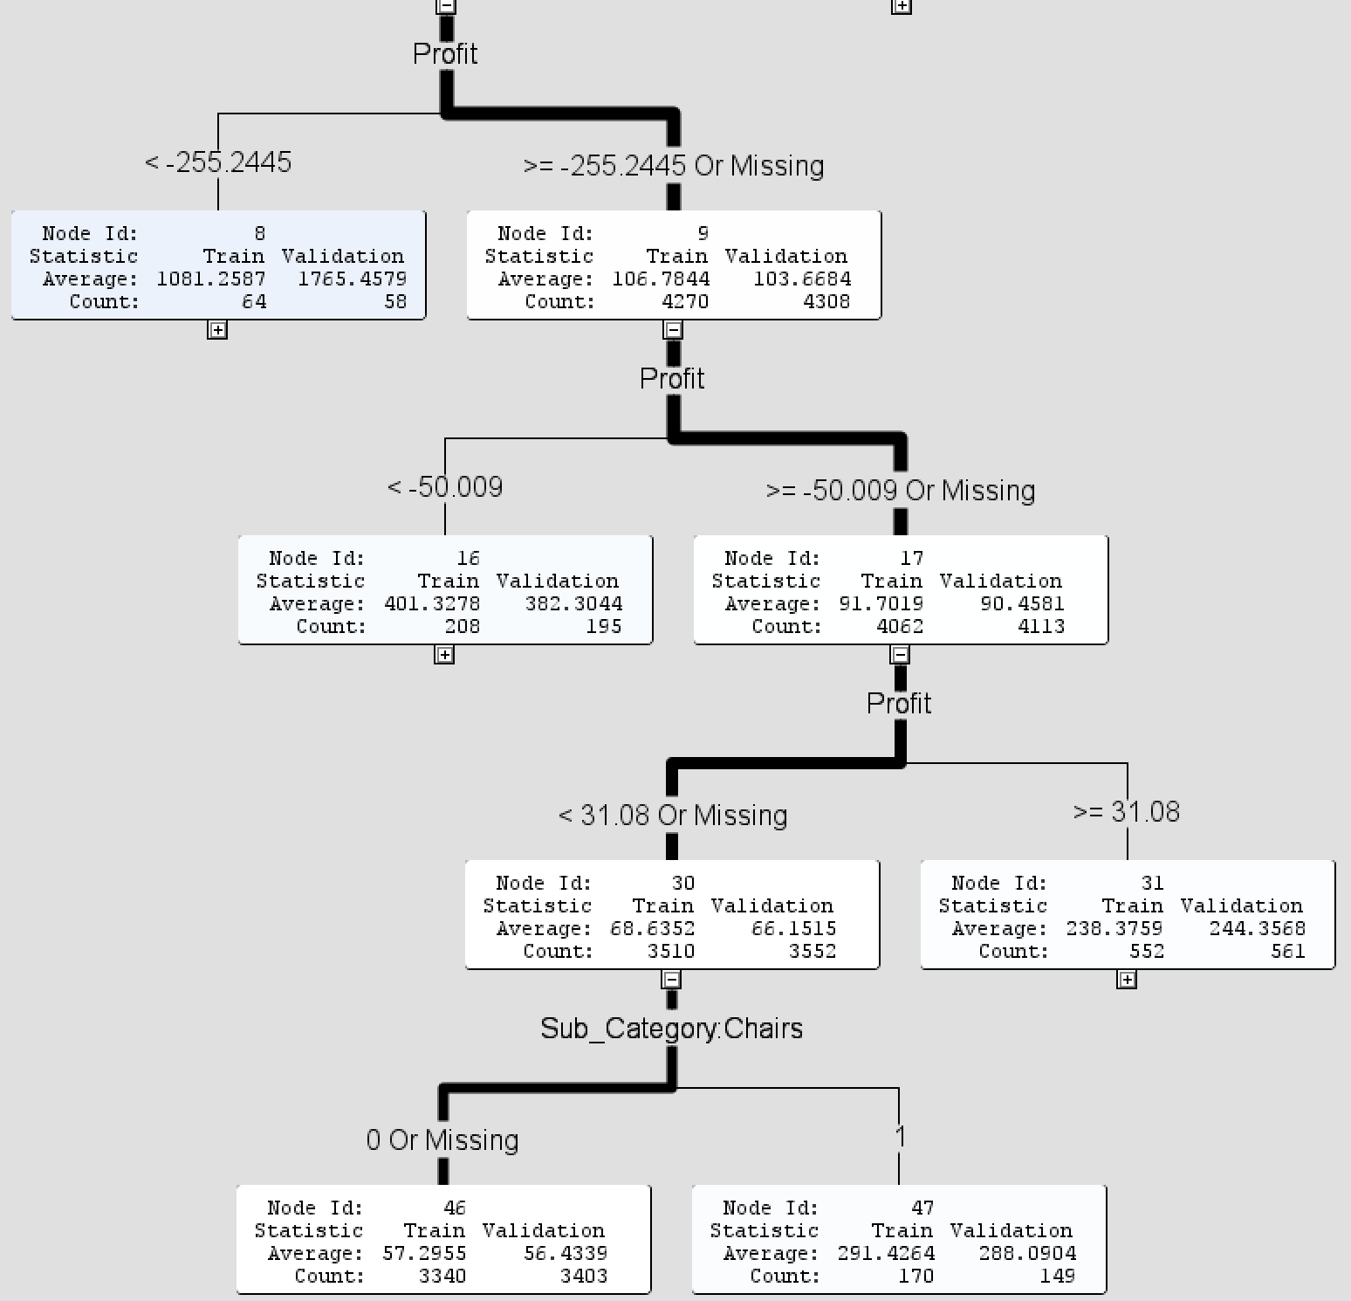

Slide 26
Decision Tree Interpretation
The dark line represents the trajectory of where majority of the records fall under.
Depending on the interpretation, this can serve as essential information for where the Superstore could take action to raise and optimize profits.
From the tree on the previous slide, we see there is a considerable amount of records comparatively less or negative profit.
This may be due to discounts or sales. Black Friday. Superstore’s loyalty rewards program.
Not always a bad thing. It can be good to get stock/inventory off the shelves.
Find ways to minimize the Count for those nodes with negative Profits and maximize those with comparatively greater Profit amounts.

Slide 27
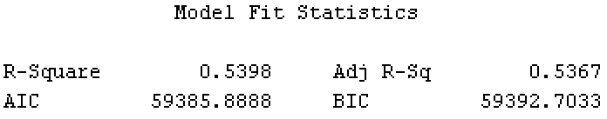
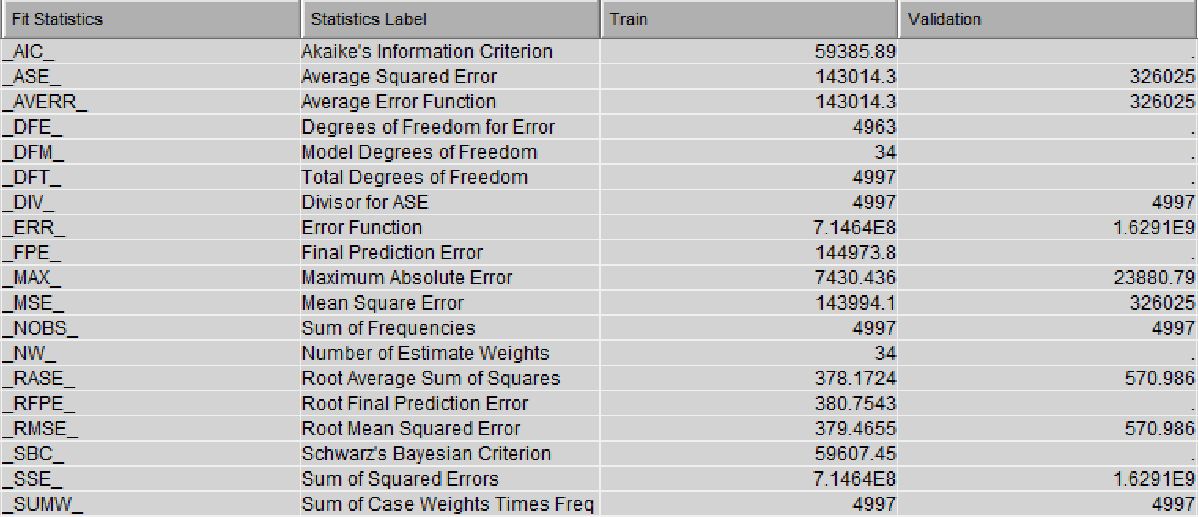
Regression Node

Slide 28
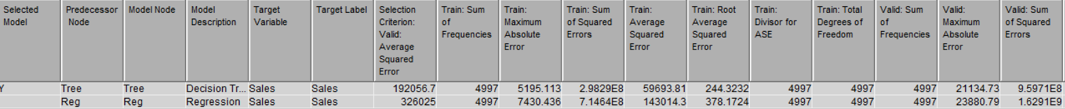
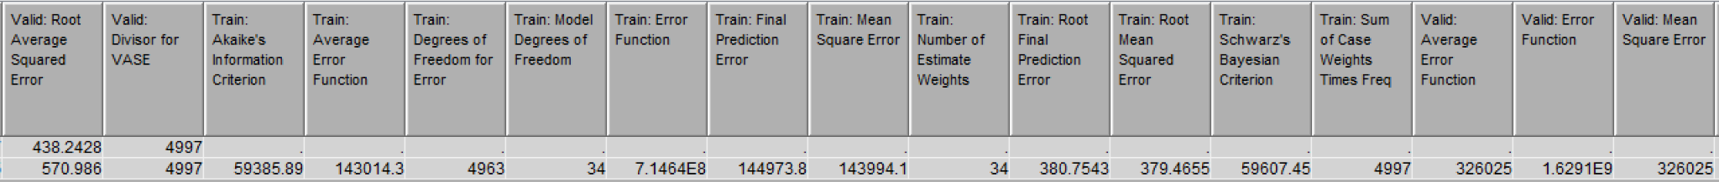
Model Comparison
This Model Comparison node takes the information obtained from the analyses performed in the Decision Tree (Tree) and Regression (Regr) nodes and presents them in a collective format.
The Regression node was needed to find the three quantities (MSE, RSME, and R-Squared).
Puts the models and analyses together that helps compare the models built.

Slide 29
Discussion
Possible biases that may exist:
Looking at the forecasts in the previous slides, Technology is the category with the highest predicted sales dollars. It can be inferred this is due to products within the technology category possessing prices greater than those of within the Office Supplies or Furniture categories. Additionally, it depends on exactly what kind of product relevant to the category is sold and accounted for. ($35 Pocket watch vs. $125 office chair; $1,600 laptop vs. $425 coffee table).
This is not suggesting that the superstore should exclusively sell Technology products. Otherwise, it would be hard pressed to call it a superstore.
The R-Squared obtained from computing the Decision Tree is notably less than 0.70.
This implies that Underfitting is present to an extent.
Various combinations of accepted and rejected variables were considered in our computations.

Slide 30
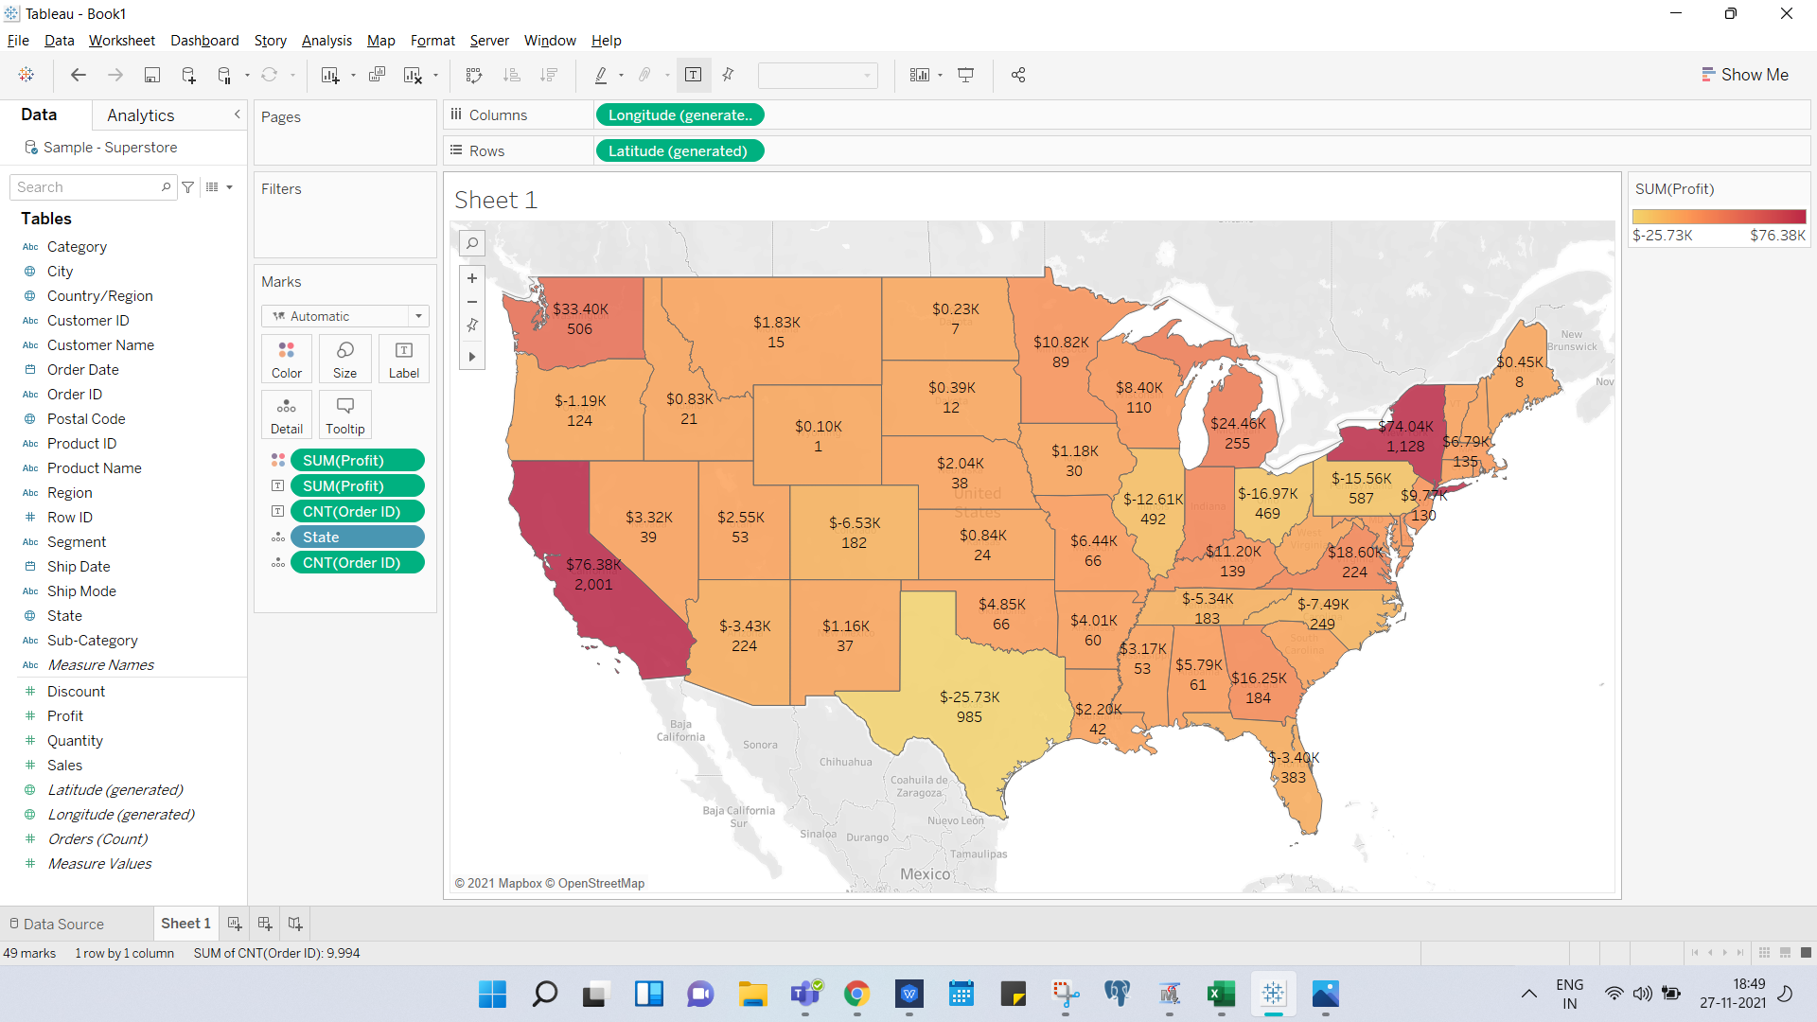
Recommendations
The Map showcases the total number of order and sum of profits with respect to each state.
Shut down branches with less number of orders.
Invest more in stores which yield greater orders, sales, and profit.
Open more stores in profitable areas.

Slide 31
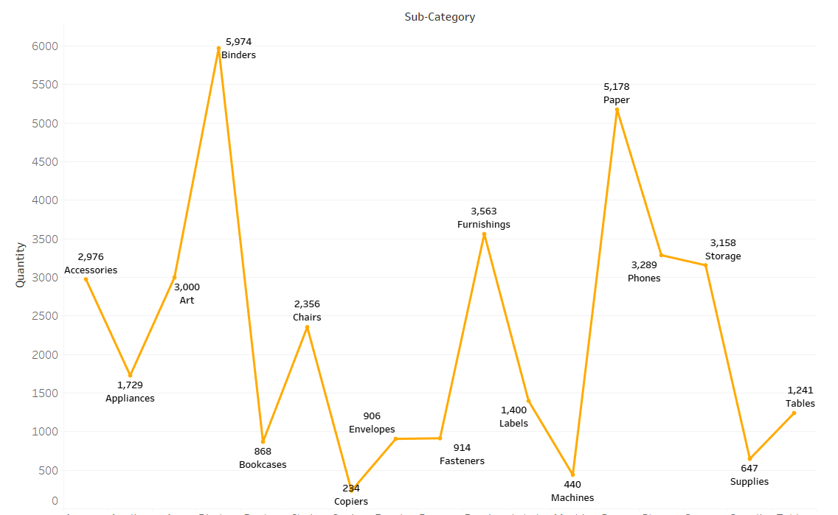
Recommendations
With accurate forecasting, we could prevent Out of Stocks problem.
Can increase the marginal price of items, which are being sold in large numbers.
Advertise on items which are being sold in less numbers.

Slide 32
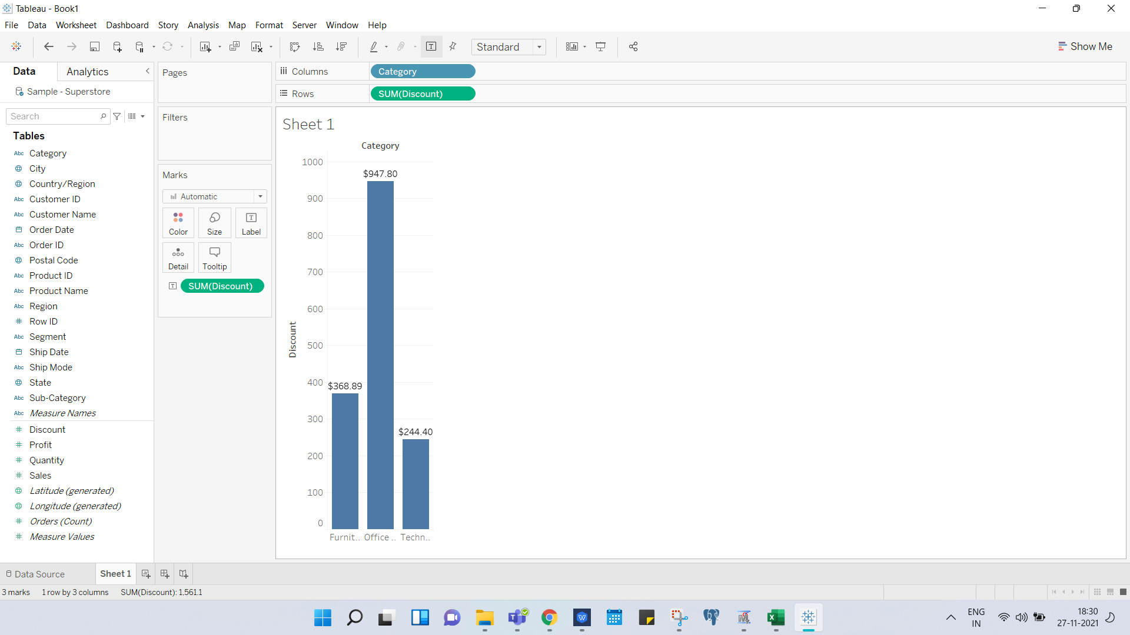
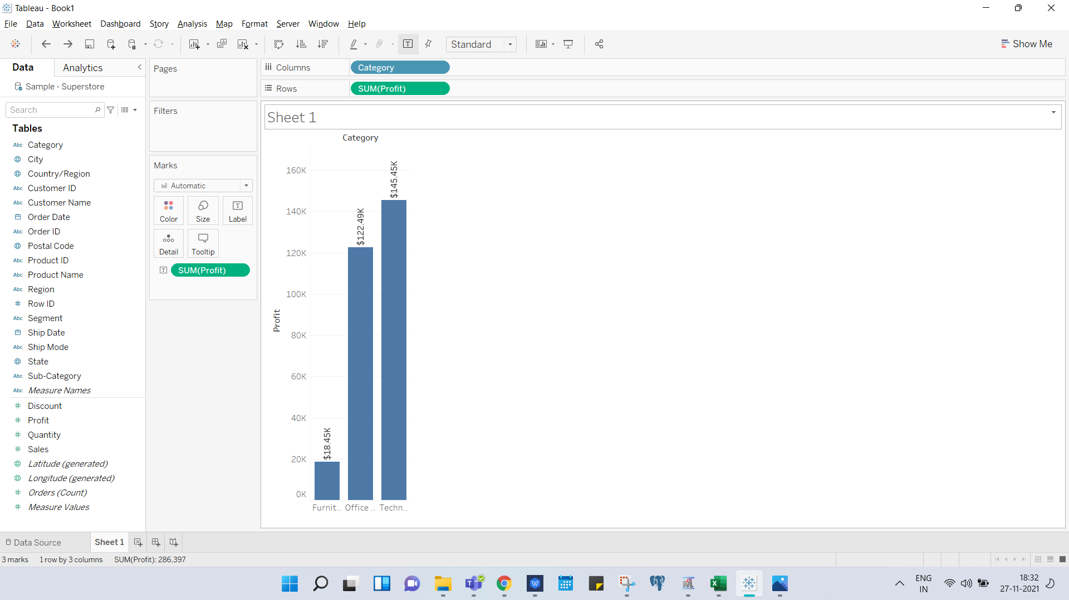
Recommendations
Although the Technology category did not provide as much discount in comparison to the other two categories, its profit turned out to be the highest.
As a result, we would recommend not to provide any discounts.
Discounts does not play any major role in boosting up the sales or profits when it comes to this store.

Slide 33
Citations
Brown, Lorna. “Superstore 2021.” data.world, 20 Apr. 2021, 3:49 AM, https://data.world/missdataviz/superstore-2021.

